Slide 1




prioritizr Systematic conservation planning in R R
Richard Schuster & Jeffrey Hanson
jeffrey.hanson@uqconnect.edu.au
prioritizr.net

Slide 2

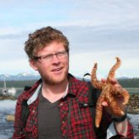

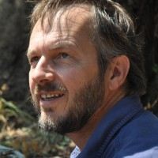
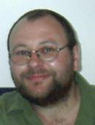
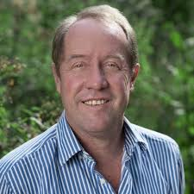
Acknowledgements
Matt Strimas-Mackey
Nina Morrell
Matt Watts
Joe Bennett
Peter Arcese
Hugh Possingham

Slide 3
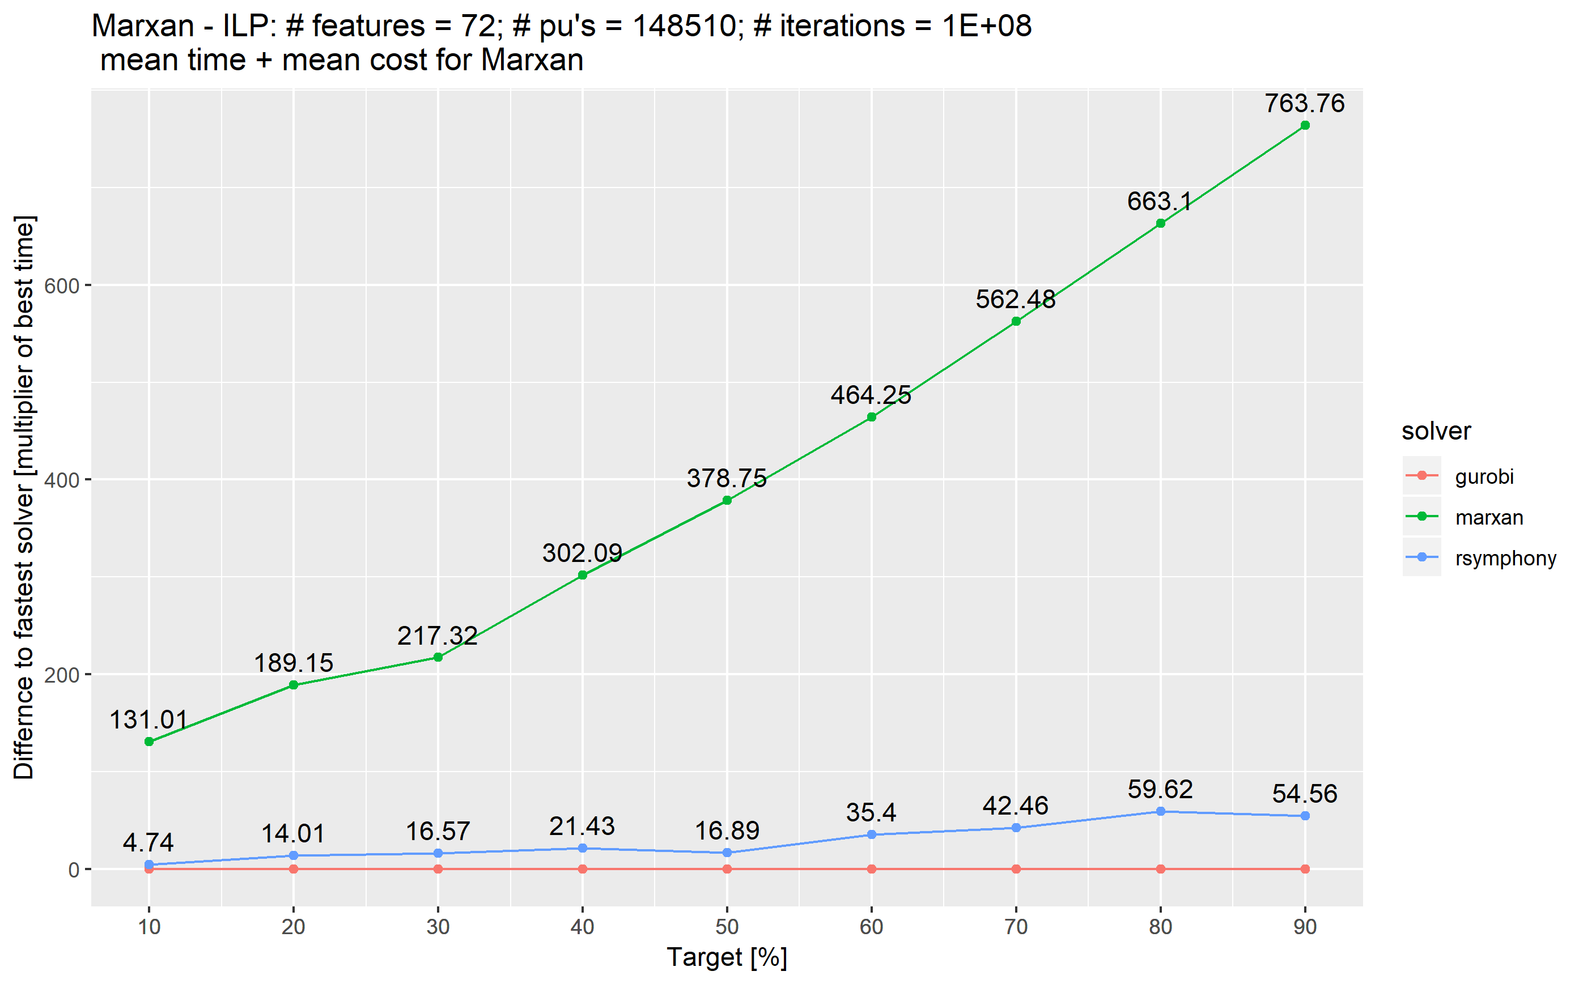
Simulated annealing vs ILP

Slide 4
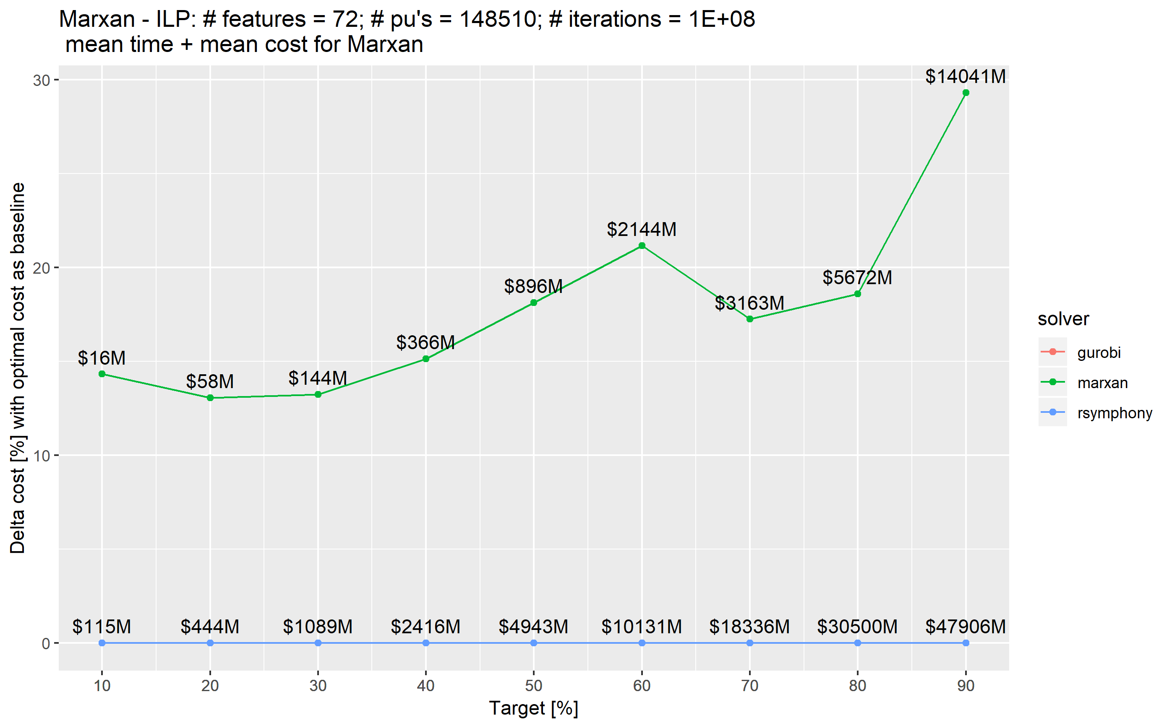
Simulated annealing vs ILP

Slide 5


The vision
Flexible + powerful framework
+ User friendly (browser) interface
= A novice stakeholder can devise a high-quality, data-driven spatial plan in just one hour.
prioritizr.net

Slide 6
How should $we
$manage $areas to
$achieve
$conservation?

Slide 7






Slide 8
Objective
Maximize number
of populations
in reserves,
subject to budget?

Slide 9
Objective
Maximize number
of threatened
populations in
reserves,
subject to budget?

Slide 10
Objective
Maximize
phylogenetic
diversity in reserves,
subject to budget?

Slide 11
Objective
Minimize cost,
subject to targets to
ensure adequate
representation
in reserves?

Slide 12
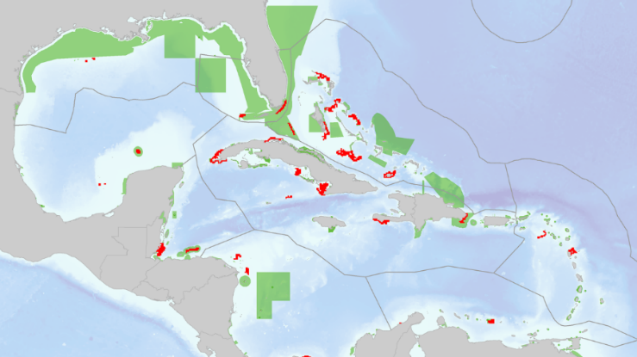
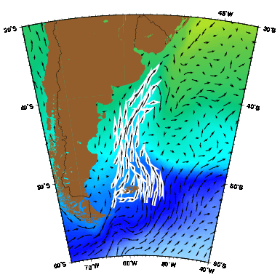
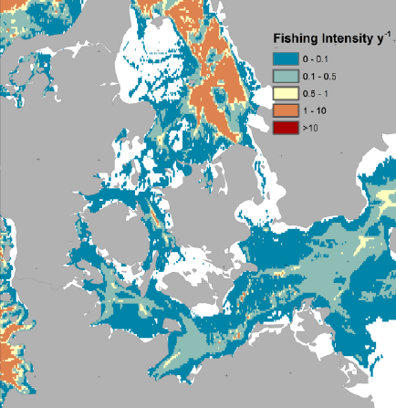
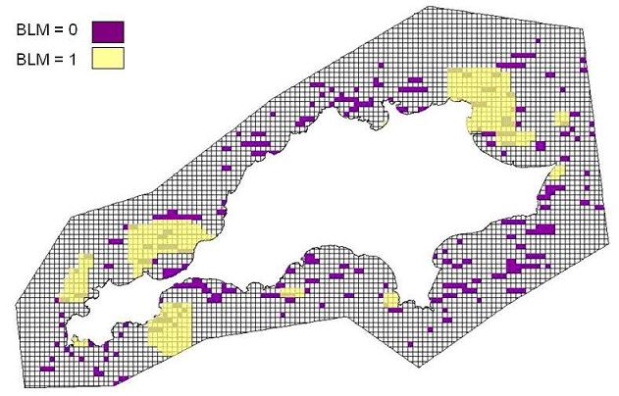
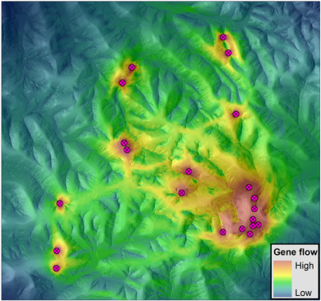
Constraints and Penalties

Slide 13
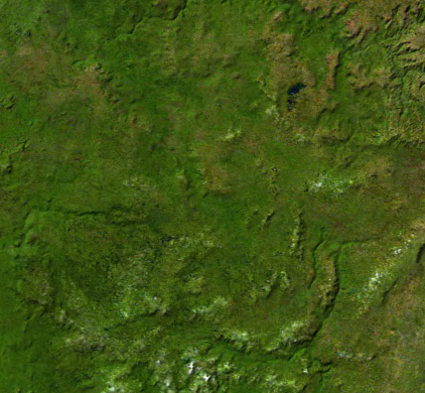
Decision type
Protect or not?
Different amounts?
Multiple actions?

Slide 14





Solver
?
?
?
?

Slide 15
Why R?

Slide 16

prioritizr
Design your problem
Find optimal solutions
Ideally, fast!

Slide 17
Design your problem
Mental model
problem <- data +
objective +
constraints +
penalties +
decision type +
solver
solution <- solve(problem)

Slide 18
Design your problem
Mental model
Code
problem <- data +
objective +
constraints +
penalties +
decision type +
solver
solution <- solve(problem)
p <- problem(pus, feats) %>%
add_min_set_objective() %>%
add_relative_targets(….) %>%
add_boundary_penalties(….) %>%
add_binary_decisions() %>%
add_rsymphony_solver()
solution <- solve(p)

Slide 19
Design your problem
Objectives
add_max_features_objective
add_max_phylo_objective
add_max_utility_objective
add_min_set_objective
Penalties
add_connectivity_penalties
add_boundary_penalties
add_feature_weights
Decisions
add_bindary_decisions
add_proportion_decisions
add_semicontinuous_decisions
Constraints
add_feature_contiguity_constraints
add_contiguity_constraints
add_locked_in_constraints
add_locked_out_constraints
add_neighbour_constraints
Solvers
add_gurobi_solver
add_lpysmphony_solver
add_rsymphony_solver

Slide 20
Design your problem
problem(pu, fts, "cost") %>%
add_min_set_objective() %>%
add_relative_targets(…) %>% add_binary_decisions() %>%
solve()
Single zone
problem
problem(pu, zones(fts_z1, fts_z2, …),
c("cost_1", "cost_2", …)) %>%
add_min_set_objective() %>%
add_relative_targets(…) %>% add_binary_decisions() %>%
solve()
Multi-zone
problem

Slide 21
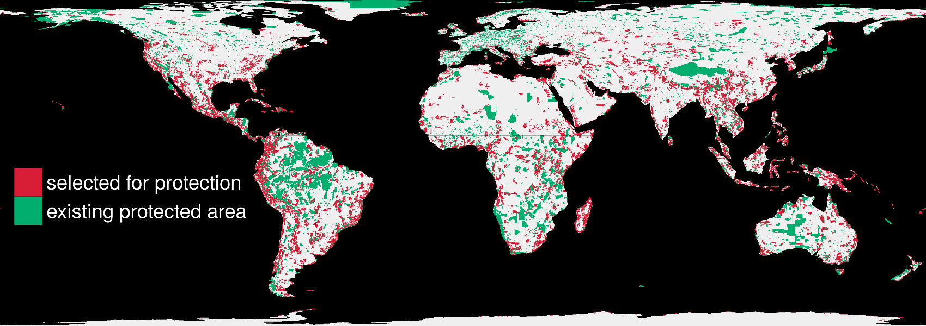
Find optimal solutions, ideally fast
1.5 million planning units + 22,644 species: 76 minutes

Slide 22
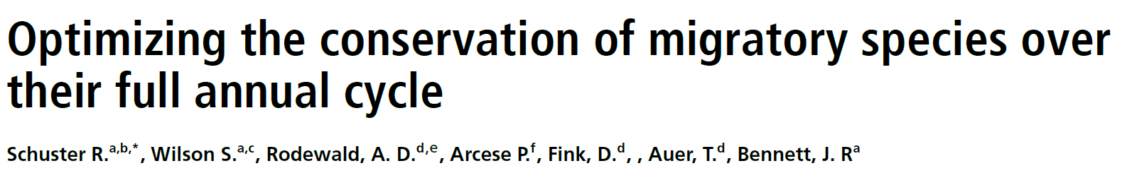
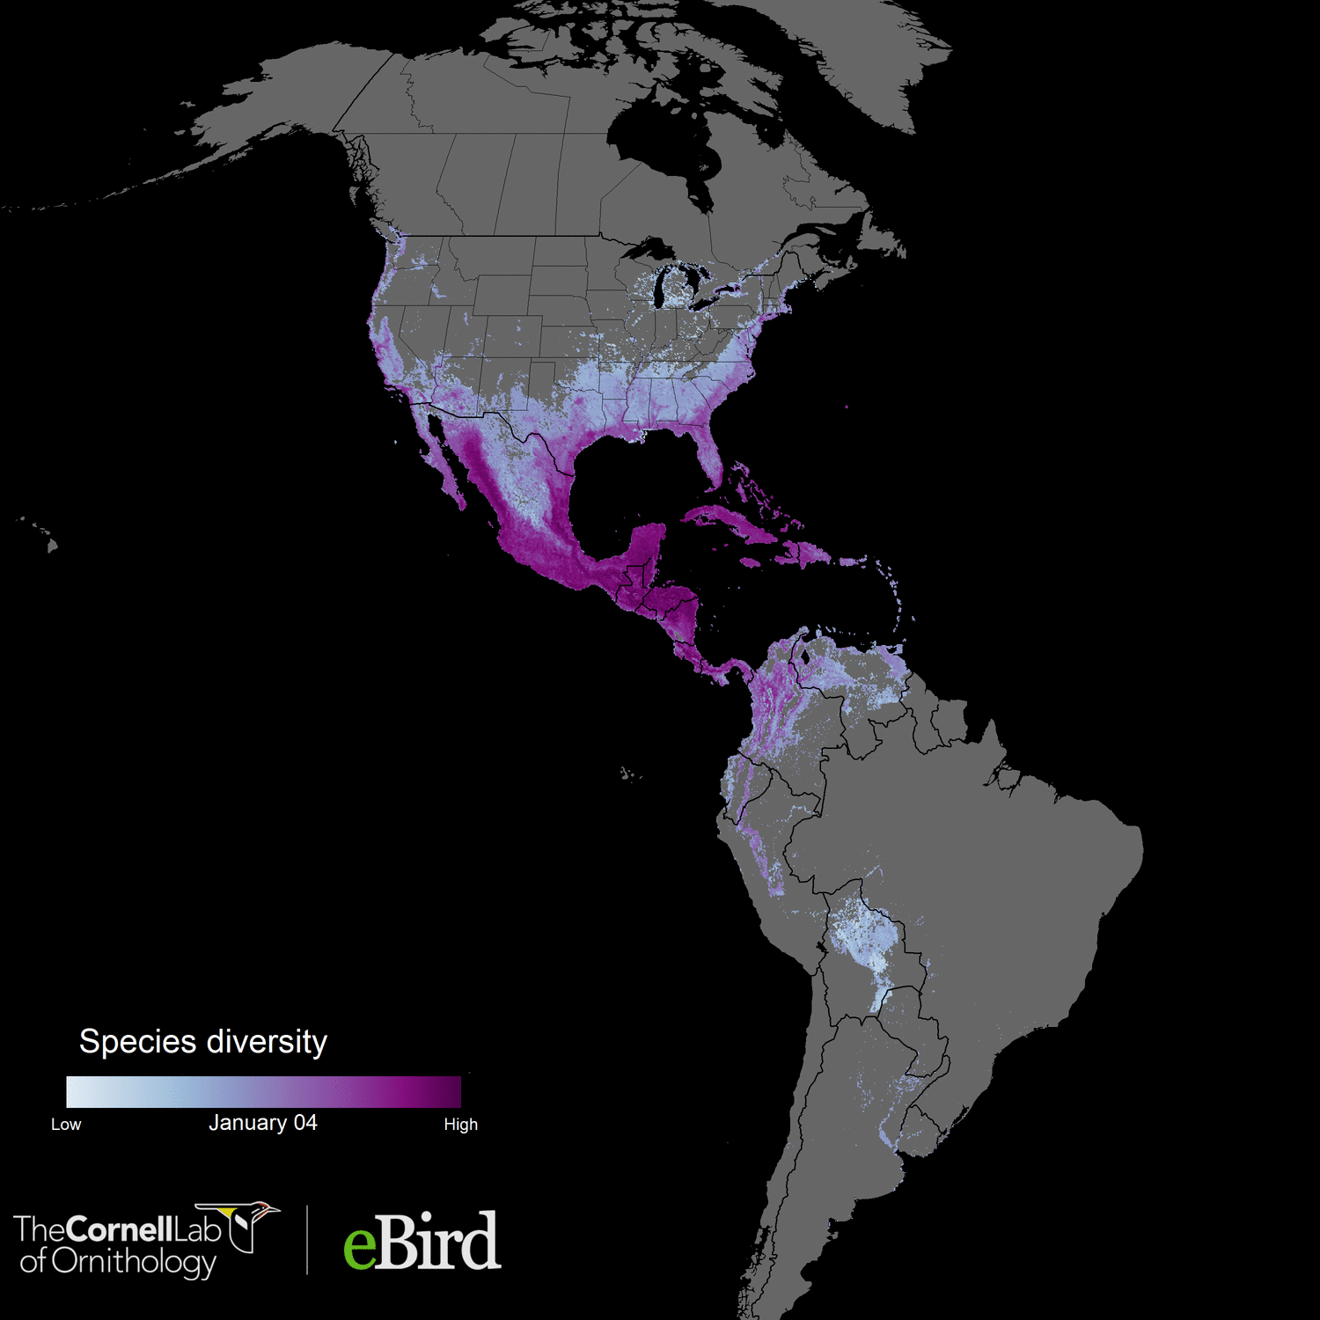

Accepted in Nature Communications
117 species
73 million km²
1.7 million unique locations
14 million checklists
~6000 (52 * 117) weekly abundance maps
1.05 million planning units
Analysis powered by:

Slide 23

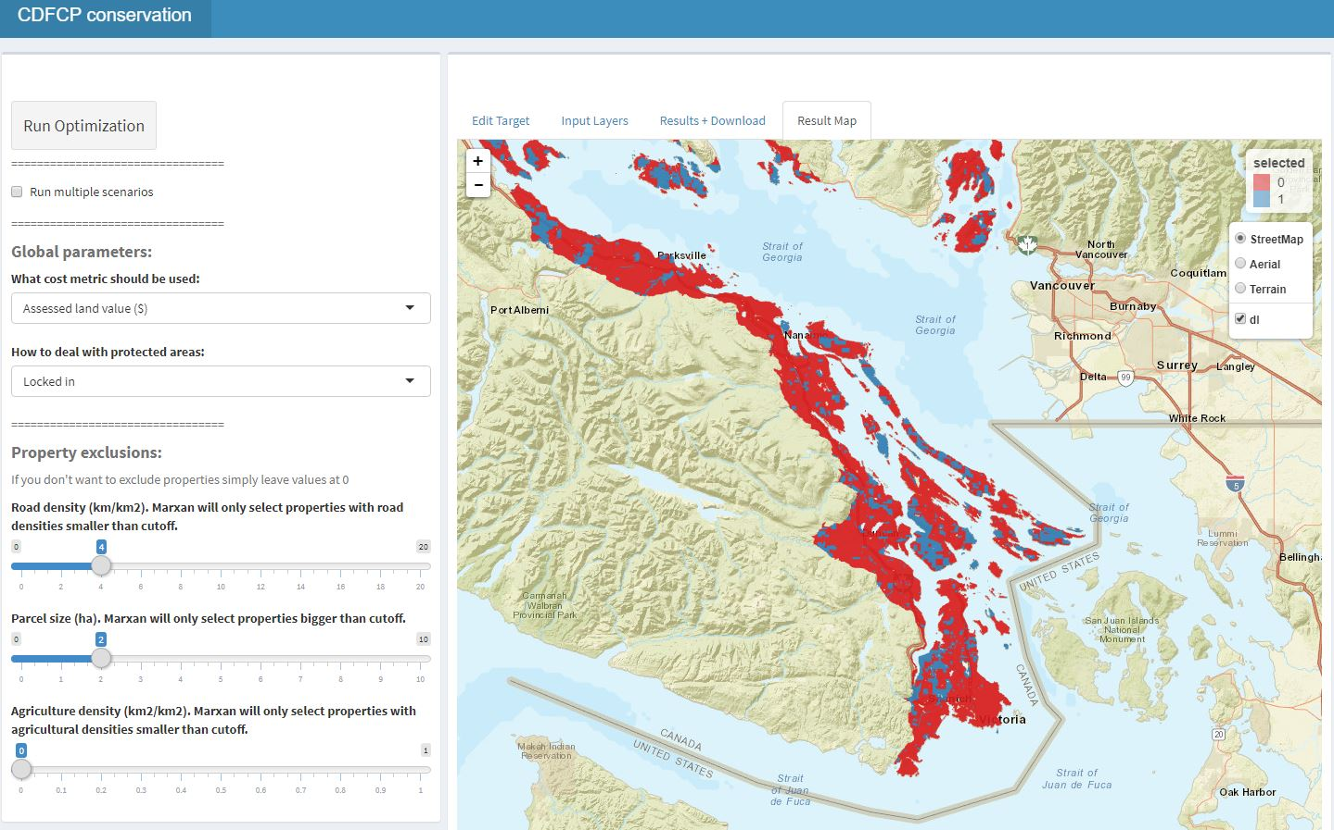
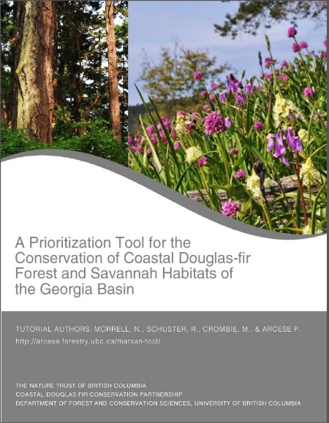
Make it user friendly!

Slide 24










Facilitate Consensus Decisions on Protection

Slide 25


Slide 26
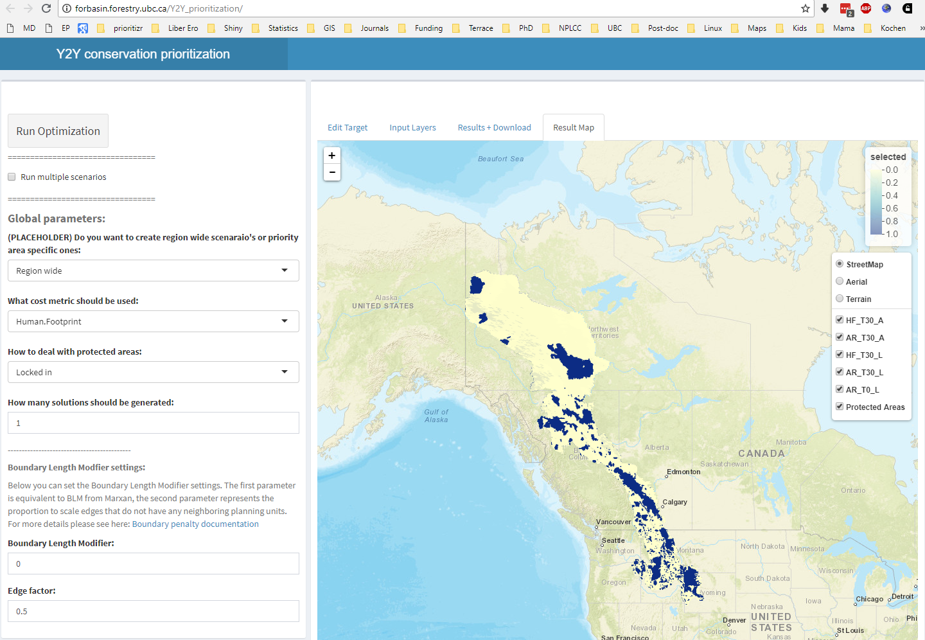
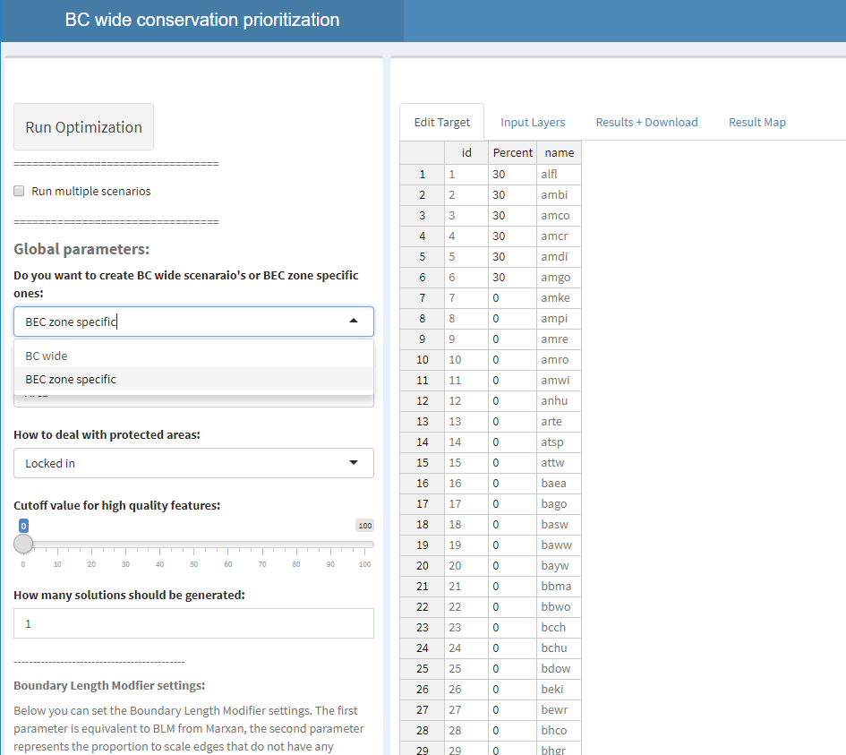

Examples where framework used
CDFCP
Y2Y
Wild Harts
BC wide

Slide 27

Take home message
Flexible + powerful framework
+ User friendly browser interface
= A novice stakeholder can devise a high-quality, data-driven spatial plan in just one hour.
prioritizr.net
jeffrey.hanson@uqconnect.edu.au
richard.schuster@glel.carleton.ca

Slide 28


richard.schuster@glel.carleton.ca
jeffrey.hanson@uqconnect.edu.au
prioritizr.net

